Slide 1
SDSC 2005 - Introduction to Computational Social Science (Lecture 6)
Hao PENG
(haopeng@cityu.edu.hk)
Department of Data Science
City University of Hong Kong
https://haoopeng.github.io/

Slide 2
Agenda for today
Observational study design
Linear regression models
Generalized linear models
Experimental study design
Lab experiment
Field experiment
Digital experiment
Case studies and examples

Slide 3
Learning objectives
After this lecture, you will be able to:
Explain why research design is the key to any CSS project
Distinguish observational vs. experimental study designs and understand their trade-offs in big digital data
Interpret & critique regression models for CSS questions
Design basic digital experiments (including A/B tests and “zero-variable-cost” studies)
Recognize pitfalls and ethical issues in CSS research design

Slide 4
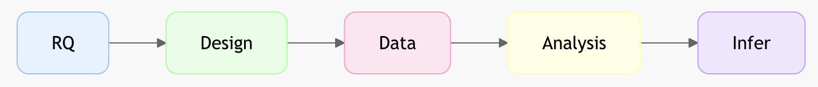
What is research design?
Blueprint that links question → data → analysis → conclusions
Ask yourself: What data to use? How to collect data? How to analyze them? How to claim causality if possible?
In CSS: we often combine the found data (digital traces) with the designed data (surveys, experiments)
Found (given) data: large scale but can’t change it in ways we want
Designed (made) data: design & collect data you want via exp/survey

Slide 5
Two broad families of designs
Aspect of difference | Observational Designs | Experimental Designs
Researcher control | Low (no manipulation) | High (manipulate treatment)
Common in CSS | Social media traces, administrative records, surveys, | A/B tests, digital platform-based field experiments, Surveys?
Causal claim strength | Weaker (confounding) | Stronger (randomization)
Scale & cost | Often cheap & huge N | Often costly and time consuming, but can be cheap
Can we conduct / collect experimental data via surveys?
Notes:
You can collect experimental data with survey!
The form of data collection is not primary consideration. The key is “does it involve randomization and treatment manipulation”.
The brevity study uses survey to collect experimental data.

Slide 6
Observational research in CSS
Strengths: Real-world, empirical, massive N, longitudinal
Weaknesses: Selection bias, confounding, no randomization
Most common starting point:
Twitter, Facebook, Reddit, Wikipedia
mobile metadata, government records
OpenAlex, USPTO, Altmetric, Github, etc.
Example:
Predicting toxic / abusive content in social media posts
Studying how network structural impact political polarization
Examining how team diversity relates to team performance
……

Slide 7
Key principles of good design
Construct validity (are we measuring what we think?)
Statistical validity (robustness to measurement errors)
Internal validity (Does X really correlate with / cause Y?)
External validity (Do findings generalize to other contexts?)
Observational design: Massive scale helps with statistical and external validity but also suffers on measurement (construct) and mechanistic (internal validity) biases:
Use quantifiable metrics as proxy of behavioral variables
Missing important control variables in “found” (given) data

Slide 8
Regression models
Goal: Estimate relationship while controlling for confounders.
Recall differences with correlation?
Simple linear regression:
Y = β₀ + β₁X₁ + β₂X₂ + β₃X₃ + … + ε
β₁ = change in Y for 1-unit change in X₁ (holding other variables constant)
Packages:
lm, ols in R
statsmodel in Python

Slide 9
Regression models
A step closer to “causality”: adding more control variables.
Different types of controls:
Confounding variables
Variable that can be related to both IV and DV
Extraneous variables
Variable that can affect only the DV not the IV
Fixed-effects controls
A method of controlling for all factors, whether they're observed or not, as long as they stay constant within some larger categories.
We just control for all categories within that variable. In doing so, we control for everything that is constant within that category.
Common variables: demographics, year, research topics, etc.
Notes:
E.g., in studying if AIGC increases engagement, year fixed-effects control for popularity of AI over different years.

Slide 10
Regression exercise
Q: Does brevity increase num of retweets on Twitter?
Distinguish the following variables in this study:
The number of tokens in a tweet
The number of retweets
Linguistic style (sentiment, emotion, readability score, etc)
The number of user’s followers (counted up to each post time)
Account age of user
Topics of content (sports, science, arts, etc.)
Gender, location of user
Notes:
Linguistic style is a confounder
Extraneous in grey
Fixed-effects in yellow

Slide 11
Interpreting model coefficient
Coefficient size, sign, statistical significance
How do we compare the effect size between two variables?
Example: “A one unit increase in account age is associated with 1.5 more retweets (p < 0.001), net of other variables.”
VS: “A one unit increase in follower count is associated with 0.01 more retweets (p < 0.001), controlling for other vars.”
Variable standardization is the key if comparison is needed.
Interpretation after standardization: “A one SD increase in X is associated with β (standardized coefficient) change in Y.”
Notes:
It’s like comparing the GDP increase between USA and China

Slide 12
Regression assumptions
Linearity:
The effect of X on Y may not be uniform across X values
The effect of X on Y may depend on a third variable Z
Independence (big problem with complex social data)
Many social variables are internally correlated
Examples?
Normality of dependent variable
Many social variables instead follow a power-law distribution
Examples?

Slide 13
Case study
Q: Is gender linked to likelihood of self-promotion on Twitter?
Distinguish the following variables in this study:
Author gender inferred from first name
The self-promotion status of each paper
Author productivity / citation impact / affiliation rank
Journal impact factor of the paper
Authorship position (first, last, middle)
Number of authors (team size)
Publication year of the paper
Research fields (biology, physics, psychology, CS, management, etc.)

Slide 14
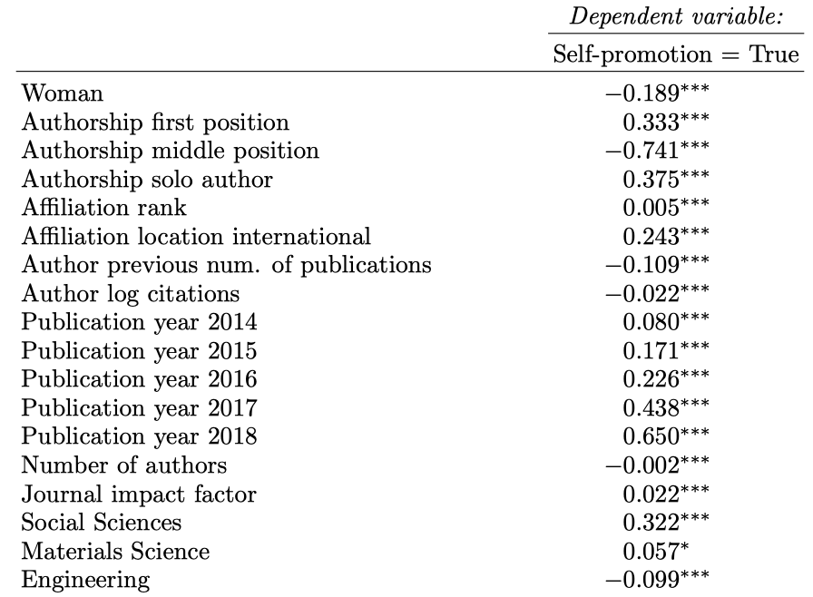
Case study
Q: Is gender linked to likelihood of self-promotion on Twitter?
Notes:
Age is a confounder,
Fixed-effects: year, ideology, gender
Personality is extraneous

Slide 15
Regression model diagnostics
Addressing linearity issue:
Self-promotion tendency does not change linearly with productivity
Add polynomial term: X²

Slide 16
Regression model diagnostics
Add polynomial term: X²
Refit the model on all data

Slide 17
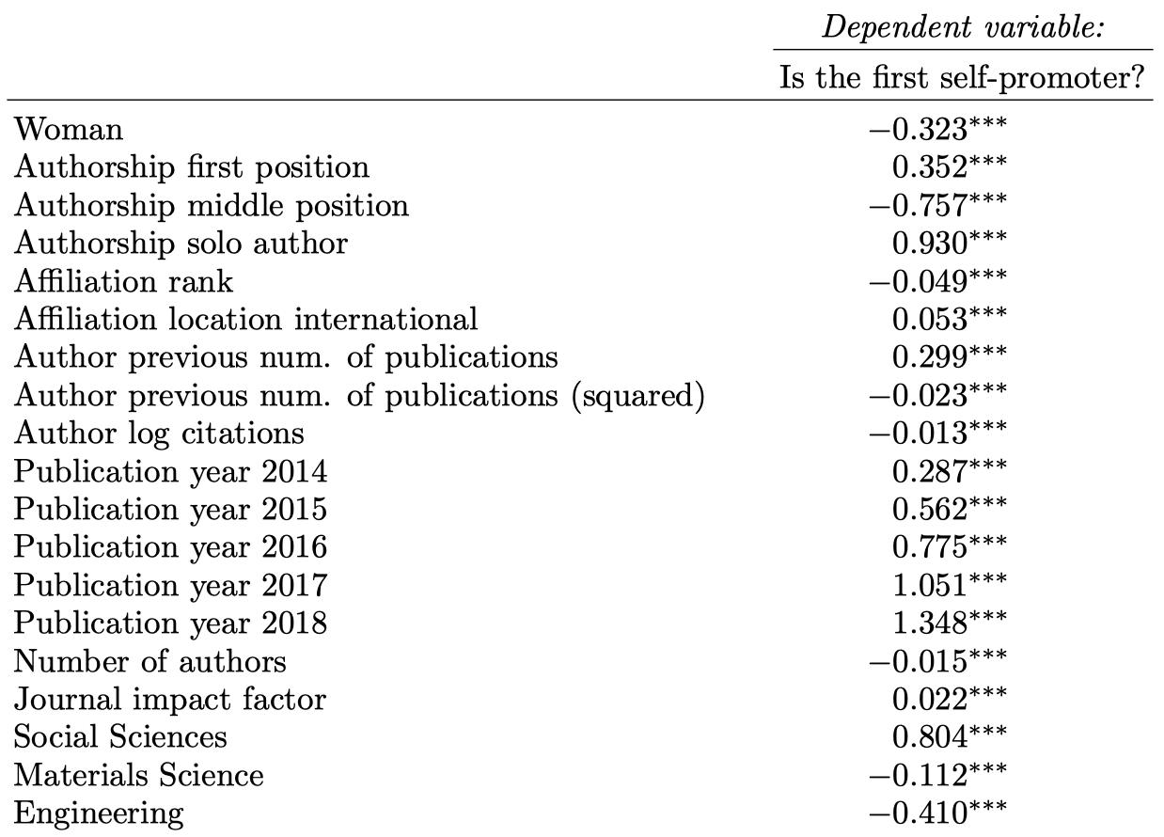
Regression model diagnostics
Add polynomial term: X²
The shape of fitted curve?

Slide 18
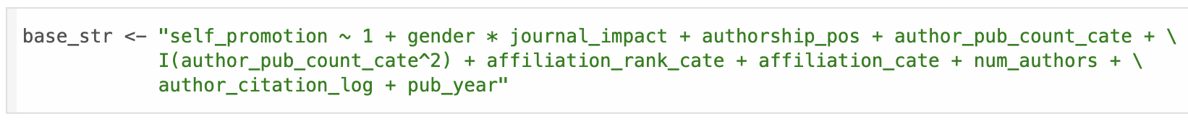
Regression model diagnostics
Addressing linearity issue:
The gender gap may change as a function of journal impact factor
Add an interaction term:
Notes:
Analogy: do you share good news of college admission on social media? What if you are admitted by CityU vs. Harvard?

Slide 19
Interaction term interpretation
DV: self-promotion of the paper by the author
Y = β₀ + β₁ women + β₂ JIF + β₃ (women・JIF) + βX + Σ
How do we interpret β₃?
Equation for men: Y = β₀ + β₂ JIF + βX + Σ
Equation for women: Y = β₀ + β₁ + (β₂ + β₃) JIF + βX + Σ
Gender gap: Delta Y = β₁ + β₃ JIF
Gender gap without interaction: Delta Y = β₁, which is fixed.
Now the gap in self-promotion changes as a function of JIF.
What’s inside X?

Slide 20
Regression model diagnostics
Multicollinearity: some control variables are correlated
team size vs. team diversity (DV = team performance)
author productivity vs. citation count (DV = paper acceptance)
num of followers vs. prior num of posts (DV = engagement of post)
VIF test
Drop variables whose VIF > 5 or 10
or transform variable (log, z-score, etc.), or use PCA
Refit model with the updated regression specification

Slide 21
Regression model diagnostics
When the normality assumption may be violated:
Transforming response variable (log, percentile, etc.)
Re-assessing normality
Consider generalized linear models (GLMs) that use a more appropriate distribution of the response variable

Slide 22
Variable transformation
Log, standardization, square root are very common choices.
Examples:
log num of followers
log citation count of a paper /an author
log applied amount in funding application
Transformations do not necessarily yield normal distributions, must still perform normality tests to see if it was successful.
Interpretation of change on transformed values is difficult. Need to be able to interpret values on their original scale.

Slide 23
Generalized linear models (GLMs)
GLMs extend the concepts of traditional linear regression to model various types of response variables that do not adhere to normal distribution.

Slide 24
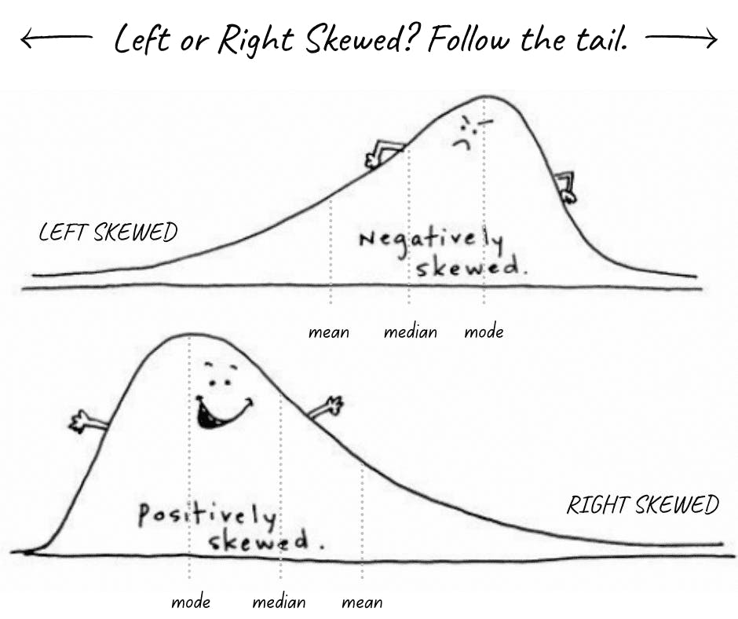
Generalized linear models (GLMs)
Right-skewed distributions:
Example of variables that follow this pattern?

Slide 25
Common GLMs
Logistic regression (last lecture)
Poisson regression
Negative binomial regression
R Packages:
glm(y ~ x1 + x2 + x3, family = binomial(link = "logit"))
glm(y ~ x1 + x2 + x3, family = poisson(link = "log"))
glm.nb(y ~ x1 + x2 + x3, data = df)

Slide 26
Logistic regression
Used to model / predict binary dependent variable.
In predictive analysis, we can use logit to build a classifier
The focus is on AUC-ROC, PR, train/test, cross validation, etc.
In descriptive analysis, we use the logit to test the statistical correlation between IV and DV, with controls.
We often fit a model to all data points.
Researchers care less about prediction accuracy.
The goal is to test robustness of correlation and p-values.
For example (categorize it?):
Predicting credit card application approval / car brands
Assessing if attendance (IV) is correlated with getting A (DV).

Slide 27
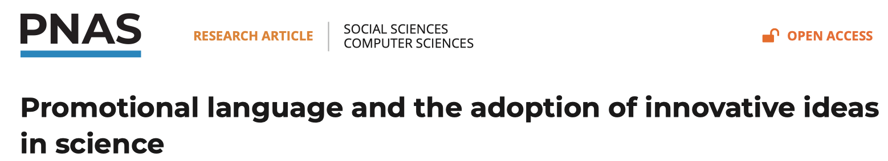
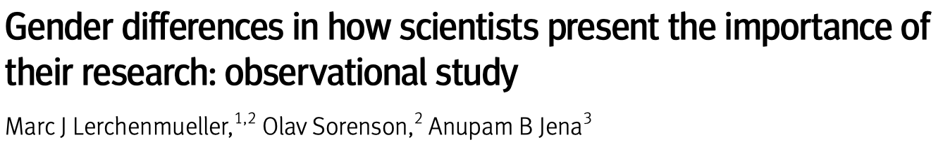
Real-world studies with logit
Is use of hype words (IV) associated with acceptance (DV)?
Is gender (IV) linked with presence of hype language (DV)?

Slide 28
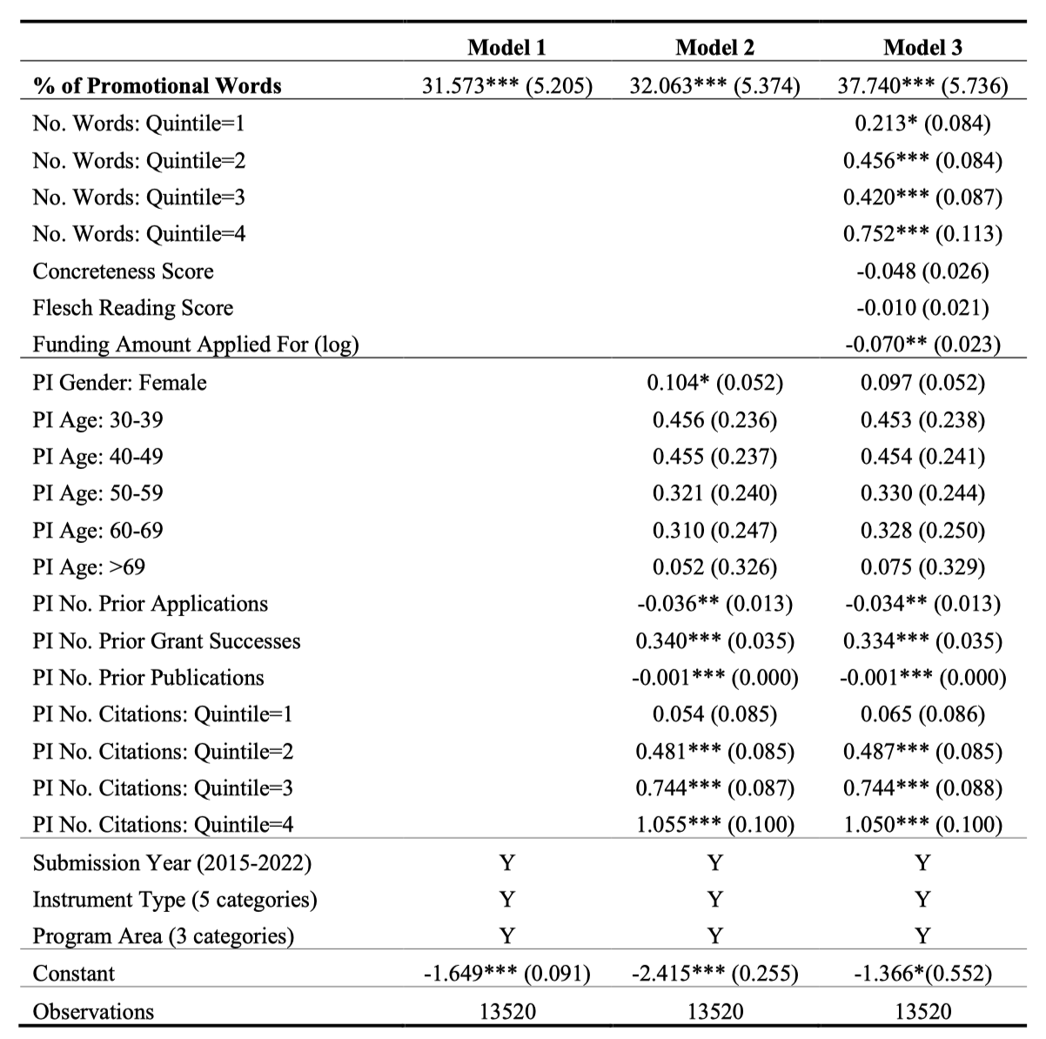
Is hype linked with funding rate?
Three sequential models help to show robustness.
Notes:
What’s IV, DV, controls, fixed-effects controls?

Slide 29
What if DV is not binary?
Let’s slightly change the research question in the previous paper:
- Is gender or age (IV) linked with num. of hype words used (DV)?
- Now, the DV is not binary
DV = total count of hype words in each paper’s abstract
Can we use linear regression instead?
What’s the range / distribution of this DV?
Can the DV be a negative value? Can it be a non-integer?
Notes:
The DV is non-negative.

Slide 30
Poisson regression
Used to model the count data where lower values of a variable have a higher frequency.
Often used to describe the occurrence of events:
Number of protests, murders
Number of successes, failures
Number of goals scored in the World Cup
In Poisson regression models, one of the major assumptions is that the mean and variance of the outcome variable are equal.

Slide 31
Poisson regression examples
Predicting these DVs:
Number of hype words used
Number of class attendance / protests
Number of votes / comments of posts
Number of paper’s citation count
Number of paper’s news coverage
Number of Github repo’s stars
Number of endorsement on LinkedIn
……

Slide 32
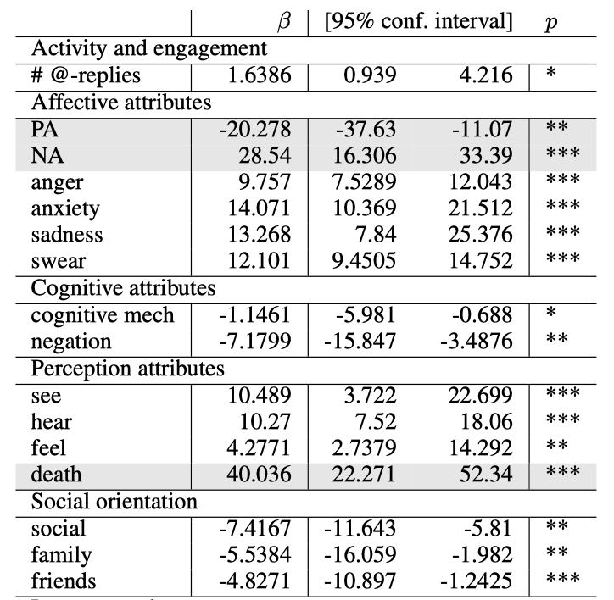
Poisson regression examples
DV = Num of state-level police killings of Blacks
IVs are word frequencies of LIWC categories
Negative emo words are positively linked with PK
Social orientation words are negatively associated with police killings

Slide 33
Negative binomial regression
Like the Poisson model, the NB regression can be used to model count data (integers) where the dependent variable is over dispersed (with many small values).
However, the NB model can be used when the variance is substantially higher than the mean.
E.g., if the DV has many many zeros.
The NBR is similar to the Poisson model, but incorporates an additional term to account for the excess variance.

Slide 34
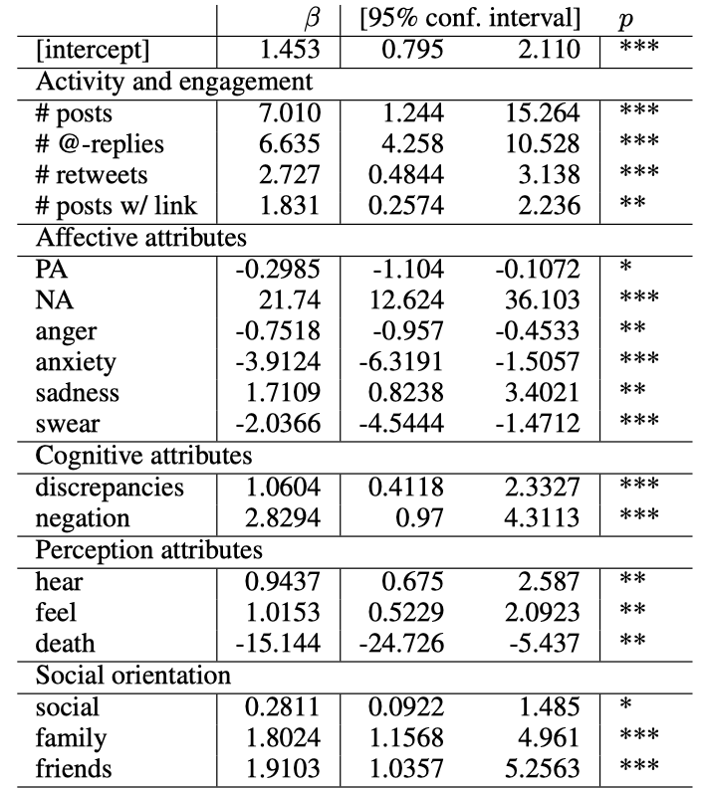
NB example
DV = protest volume
DV is over dispersed
NB is a better choice than Poisson model.
Social orientation words are positively linked with daily PV.

Slide 35
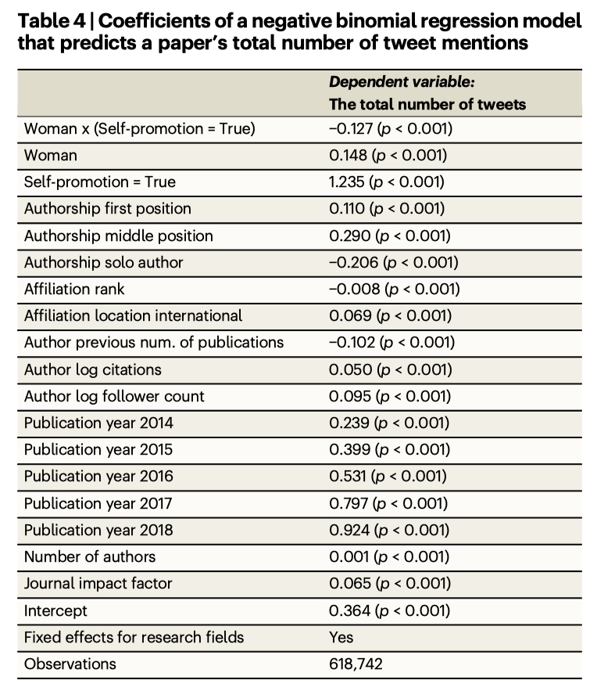
NB example
DV = num of tweets
(engagement of paper)
Many zeros in DV
Std is much > mean
We use zero-inflated NB regression model due to excessive zeros

Slide 36
Quantifying effect sizes (in GLMs)
Marginal effects of IV on the original scale of response variable
The meaning of “marginal” depends on variable type.
Continuous IV:
Change in response for 1 unit change in IV.
Use Marginal Effects at the Mean (MEM) by setting all other control variables at their mean or median values to make predictions.
Categorical IV:
Change in Y for each level of IV relative to the reference group.
Often compute Average Marginal Effects (AME) by setting control variables at values that are empirically observed in all samples.
Why is this more realistic than MEM?
R packages
margins, ggeffects
Notes:
Especially useful for GLMs because its non-linear relationship between IV and DV.

Slide 37
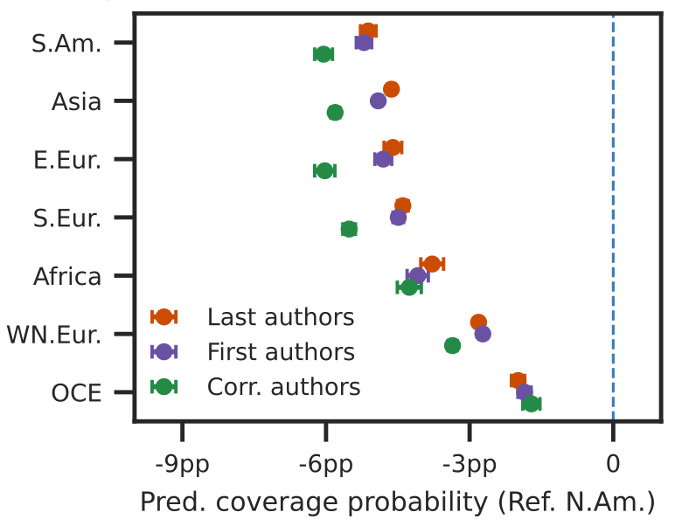
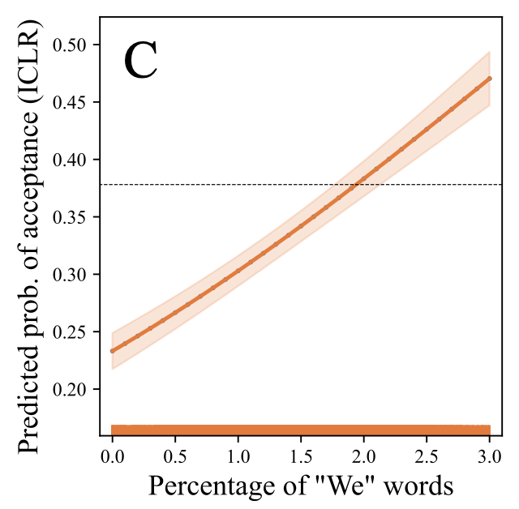
Marginal effects / predictions
Categorical IV
Continuous IV
MEs <- margins(m5, data = mydata, variables = c("author_geography”))
MEs <- ggemmeans(model, terms=c(“perc_we_words [0:0.03 by=0.001]”))

Slide 38
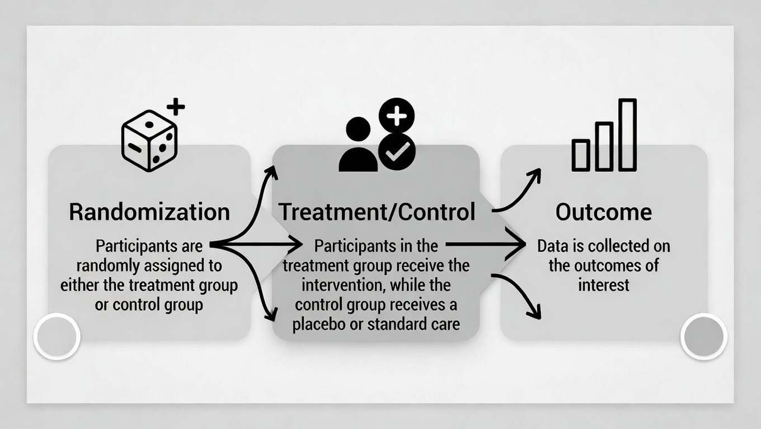
Experimental design
Weakness in observational design: unobserved confounds
Experimental strategy: Randomized controlled trial (RCT)
Gold standard for establishing causal claims
Random assignment (treatment vs. control group)
Balance on both observable and unobservable variables

Slide 39
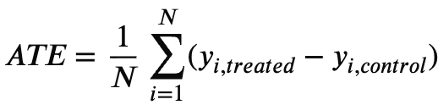
Quantifying effect size
Average treatment effect (ATE):
Compare the avg. outcome if everyone was treated vs. no one was.
Design: Two versions of the same CV, one CV assigned a Black-sounding name, the other assigned a White-sounding name. Recruit participants to rate the employability. Randomly assign participants into two groups.
With RCT design, we can simply calculate ATE by comparing the average outcome between treatment and control groups, why?
Notes:
Although only half of data is treated, …
Because each participant can belong to either group with equal chance, unlike the observational data where the treatment status (e.g. gender) is given.

Slide 40
Core elements of experiment
Clear hypothesis (IV and DV)
Pre-registered analysis plan (avoid “gaming” the exp)
Randomization (simple, stratified by demographics)
Treatment vs. control units (one or multiple stimulus)
Outcome measurement (pre/post or only post)
Power analysis (especially important with digital data)
To make sure the ATE is statistically different from 0
How much N do we need?
Notes:
One CV or many CVs

Slide 41
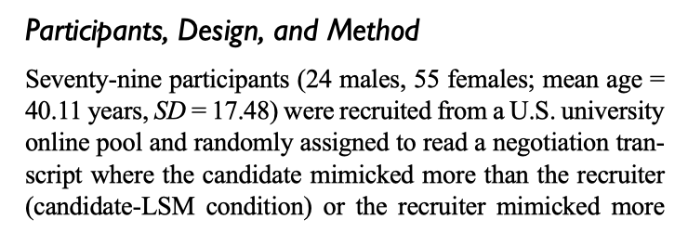
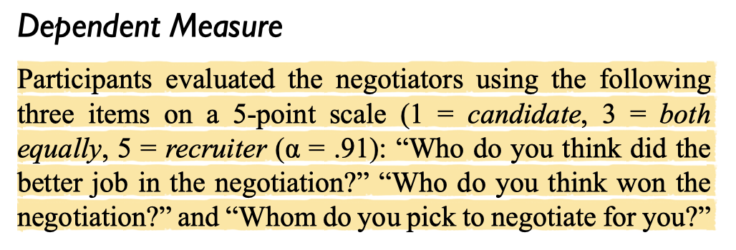
Lab experiment
Strengths:
replicable procedures, good internal validity
both IV and DV can be objectively measured
Weakness:
often conducted in an artificial setting, small N
only one (or a few) stimuli, lack of generalizability
lab env. is different from the real-world (e.g., different evaluators)
Romero et al. 2015. “Mimicry Is Presidential: Linguistic Style Matching in Presidential Debates and Improved Polling Numbers”
Notes:
Scholars vs. participants who are not trained to evaluator papers.

Slide 42
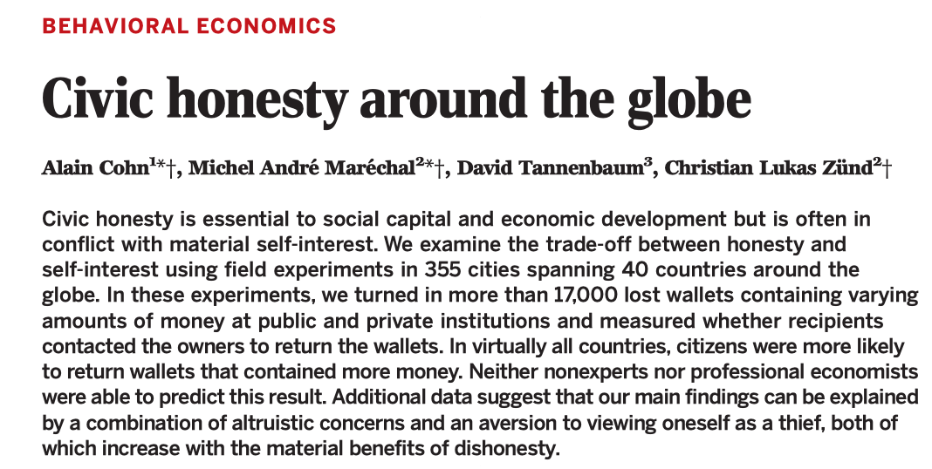
Field experiment
Manipulate an IV in a real-world, natural setting instead of artificial lab.
Strength: high external validity, participants act naturally, generalizable
Weakness:
confounds are harder to control, costly, and difficult to replicate
ethical challenges: can't practically test extreme/harmful conditions
How to do it in a lab setting?

Slide 43
Cost of experiment
Main sources of cost:
Staff time / salary
Participant reward
Solutions:
Automation (running experiment while you are taking a break)
Design enjoyable activities for participants in the experiment
In CSS: Can be done at unprecedented scale and low cost

Slide 44
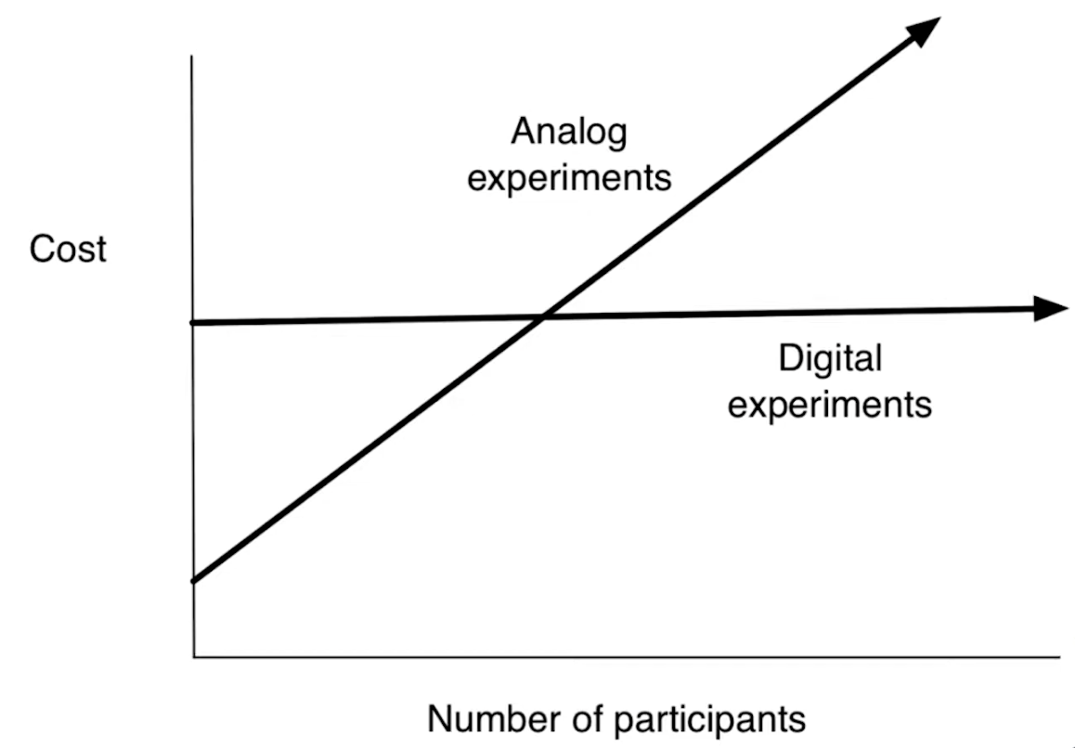
Digital/Online experiment
Recruit participants from online platforms (crowd sourcing)
Prolific, Amazon Mechanical Turk
Leverage platform infrastructure to automate the task online
Either commercial platform or build your own website
Zero-variable-cost Experiments
once the pipeline is built, adding more participants costs ~ nothing

Slide 45
Steps for digital experiments
Pre-register on OSF or similar sites
Ethical review (IRB at your institutions)
Choose platform
build your own site
Qualtrics, Prolific
Amazon Mechanical Turk, CloudResearch
Recruit / Randomize participants
Measure behavioral outcomes (clicks, downloads, shares)
Practice: How to A/B test different friend recommendation algorithms (strong vs. weak tie) on chance of finding new job.

Slide 46


Case study: how does social influence impact success of cultural products?
Hypothesis: Influence makes success unpredictable & unequal.
Ignored initially
Others get little attention
Notes:
Some famous books face initial rejections and are almost ignored at the beginning (hard to predict future success)
Majority of other songs receive little attention at all (unequal)

Slide 47
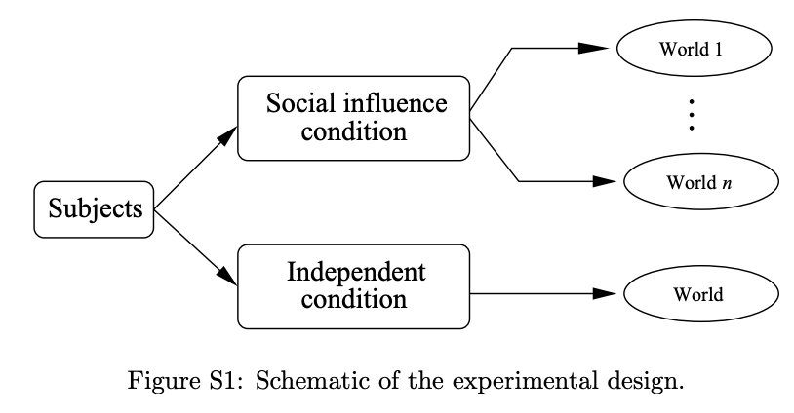
Music Lab Experiment
Classic study by [Salganik, Dodds & Watts, 2006, Science]
14,000+ participants, 48 unknown songs
(recruited from http://www.bolt. com, a website popular with young adults in the US)
Independent condition vs. 8 “social influence” worlds

Slide 48
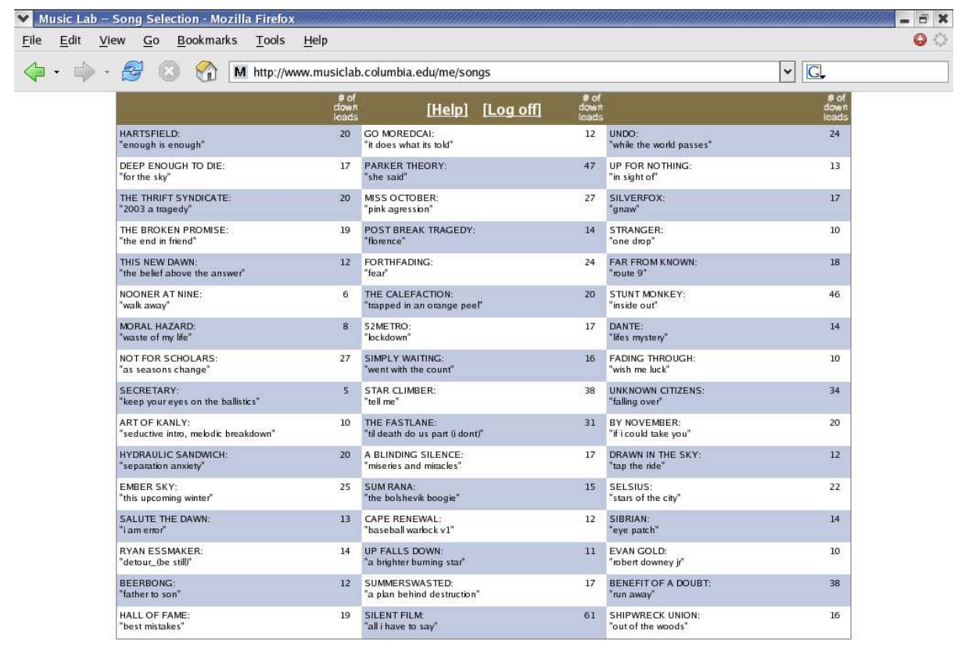
Music Lab interface / pipeline
“social influence” condition: download counts are shown
Independent condition: download information is hidden

Slide 49
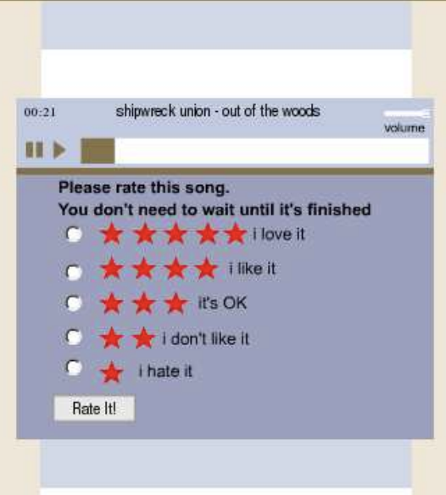
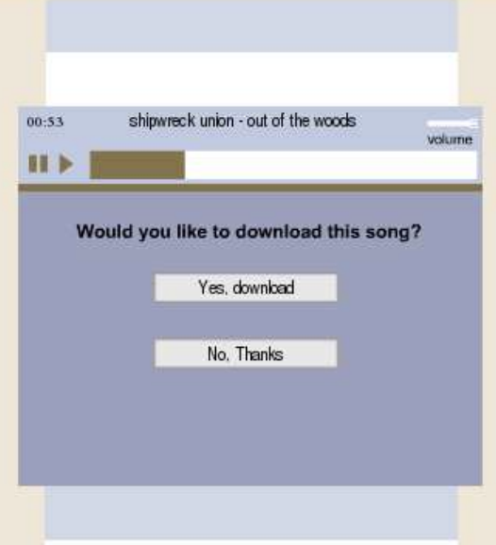
Music Lab outcome measurement
DV: rating and download

Slide 50
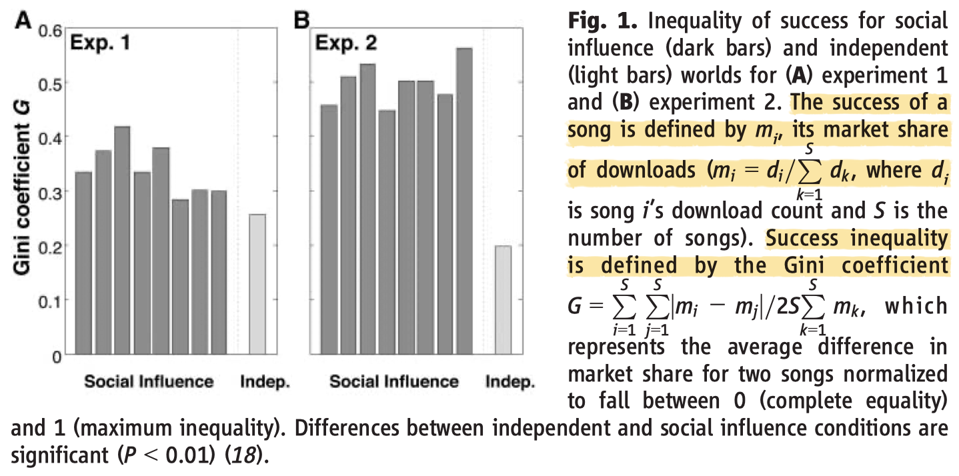
Music Lab experimental findings
Social influence creates inequality in cultural markets
(they even ran a 2nd experiment due to the zero-cost design)

Slide 51
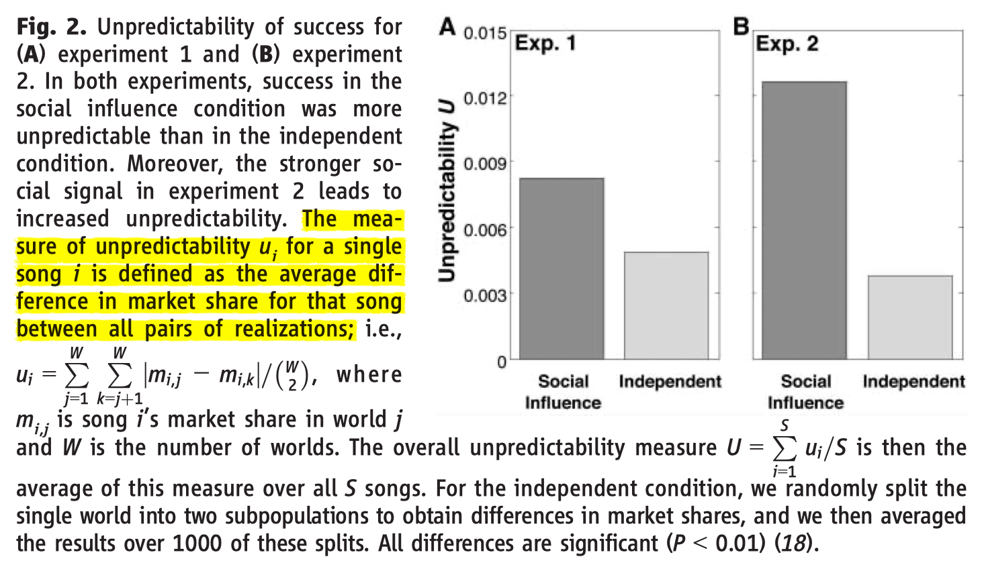
Music Lab experimental findings
Social influence creates unpredictability in cultural markets
In the 2nd exp, songs are ordered by their download counts (shows a stronger signal for social influence)
Notes:
Pairwise difference in 8 worlds (not std.)

Slide 52
You experiment
Todo in future

Slide 53
We simulated experiment
Todo in future

Slide 54
Issues for two research designs
Observational: large scale but suffers from confounding and selection biases, weak in causality, cheap (data & code)
Experimental: strong in causal claims and mechanisms but lacks generalizability, time consuming and costly (field exp)
Best practices: combine both designs
Obs: Use diverse datasets, open data/code, causal inference
Exp: pre-registration, replication (rounds), power analysis, ethics

Slide 55
Summary
Research design = the most important decision you make
Observational studies → great for description & exploration
Experiments → causal claims & understanding mechanisms
CSS makes them easier than ever
Large open empirical datasets, open-sourced statistical models
Digital platforms for recruiting participants / performing tasks

